Slide 1
Data Analytic Job Market-Trends & Visualization

Slide 2
HELLO!
I am,
Xilonem, Andreas, Tien
and Andrew

Slide 3
Data analytics is the future, and the future is NOW! Every mouse click, keyboard button press, swipe or tap is used to shape business decisions. Everything is about data these days. Data is information, and information is power.
Radi, data analyst at CENTOGENE

Slide 4
OVERVIEW
◉Comparing and contrasting different data analytics positions/titles.
◉Comparing part-time/full-time positions in Data Analytics positions. What experience levels are in high demand?
◉What is the average salary based on professional experience? What are the standard Job titles in Data Analytics?
◉What is the US median income/top salaries compared to other countries?
◉What is the average salary range in the United States? What is the average min/max salary in the United States and for other countries?

Slide 5
DATA ANALYTICS- JOB MARKET IN THE UNITED STATES AND IN OTHER COUNTRIES
1

Slide 6
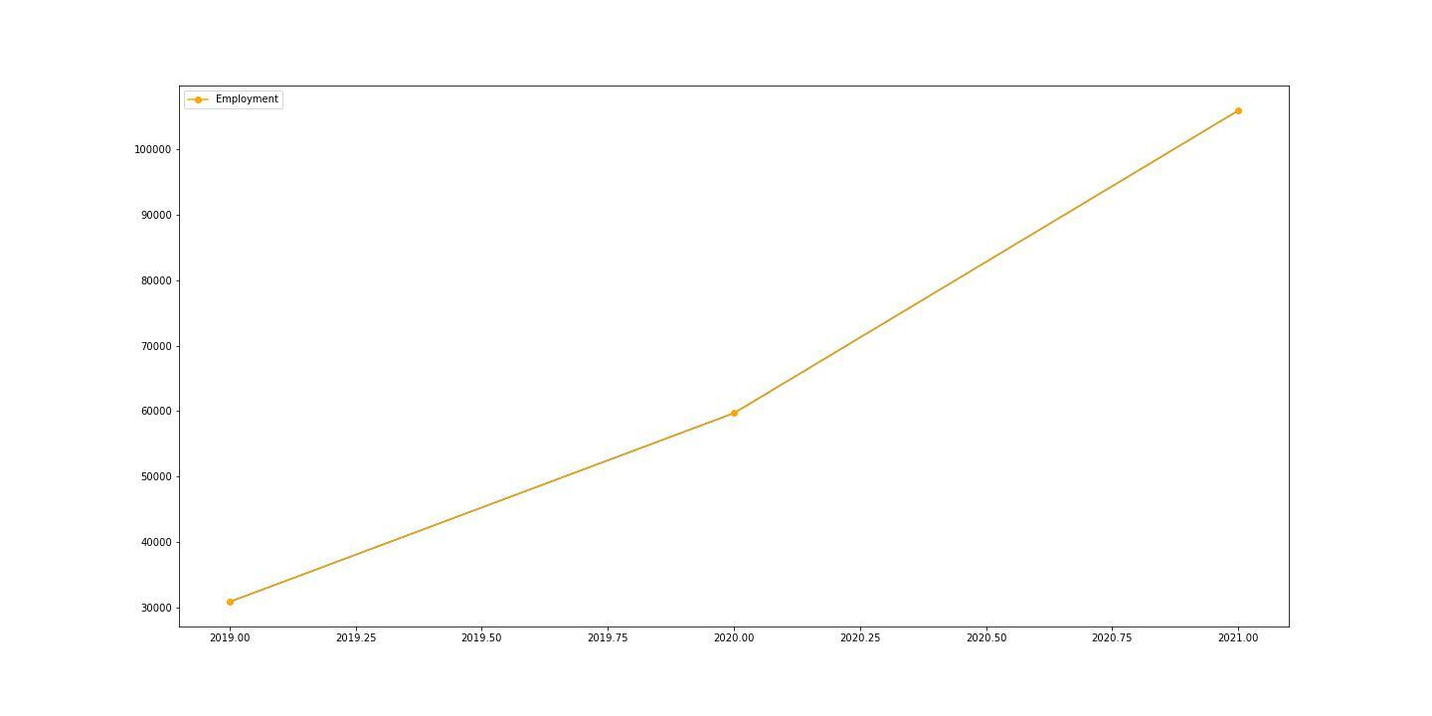
BUREAU OF LABOR STATISTICS, (OEW)
DATA SCIENTIST AND MATHEMATICAL SCIENCE OCCUPATIONS

Slide 7
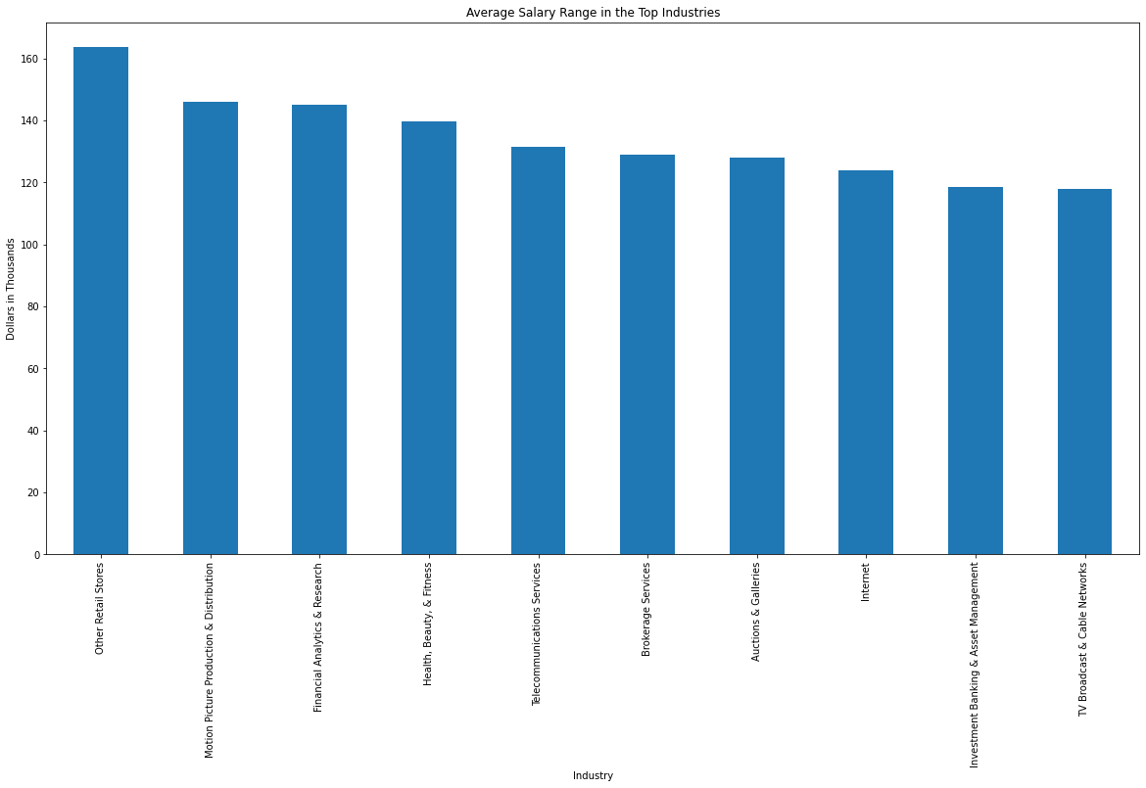
GLASSDOOR- AVERAGE SALARY RANGE IN THE TOP 10 DATA ANALYTICS INDUSTRIES

Slide 8
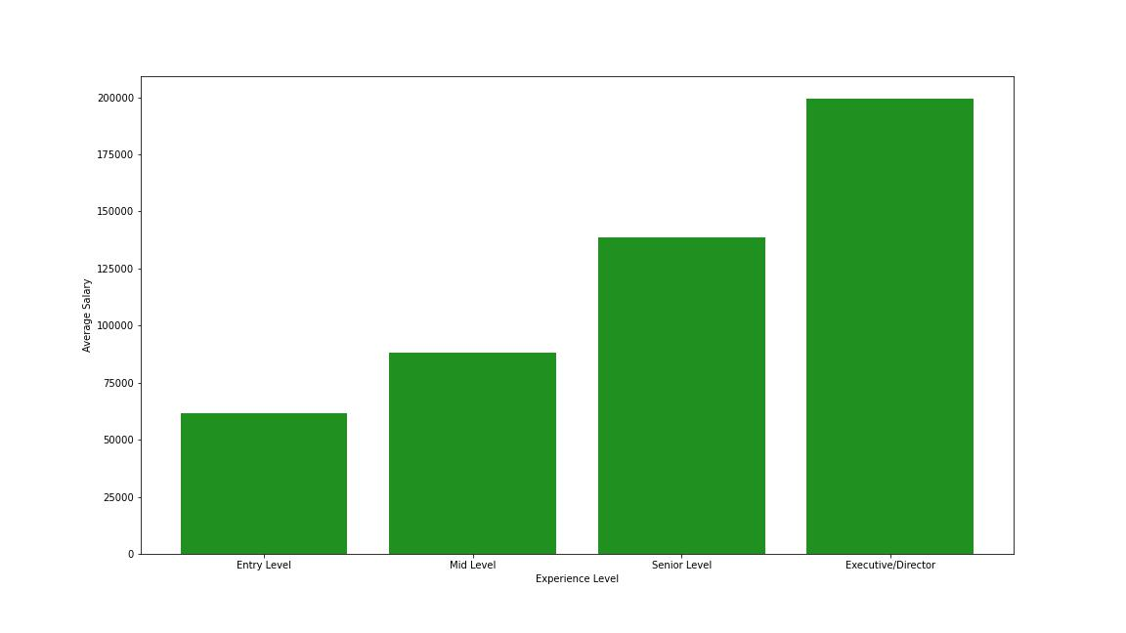
AVERAGE SALARY BASED ON EXPERIENCE LEVEL

Slide 9
POPULAR JOB TITLES AND PART VS FULL TIME
2

Slide 10
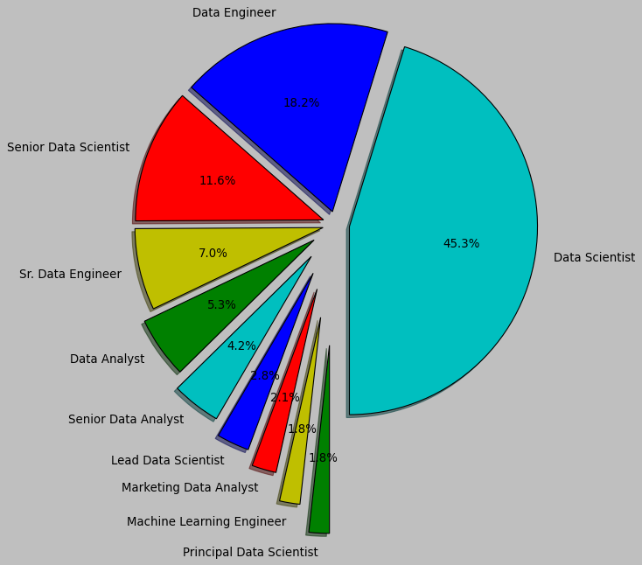
GLASSDOOR- TEN COMMON JOB TITLES IN DATA ANALYTICS

Slide 11
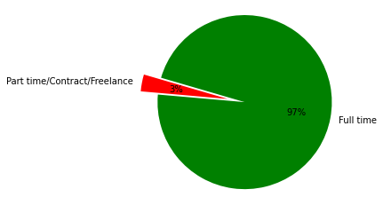
PART TIME, FULL TIME COMPARISON

Slide 12
SALARY TRENDS IN THE US VS OTHER COUNTRIES
3

Slide 13
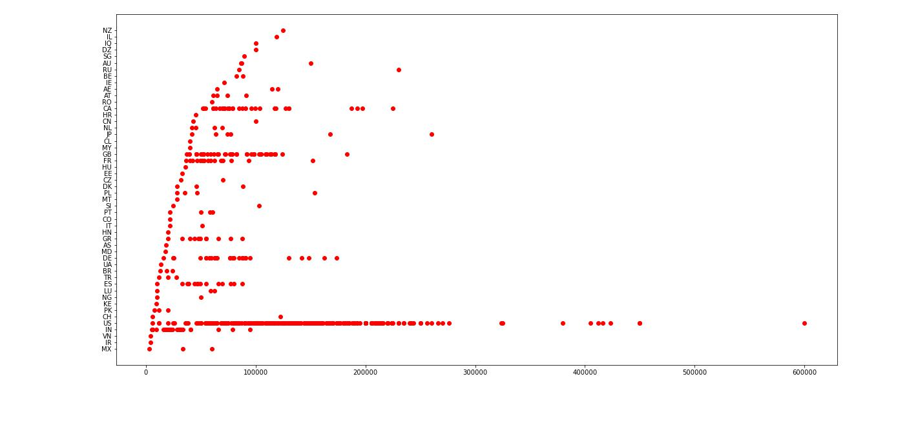
AVERAGE SALARY BY COUNTRIES

Slide 14
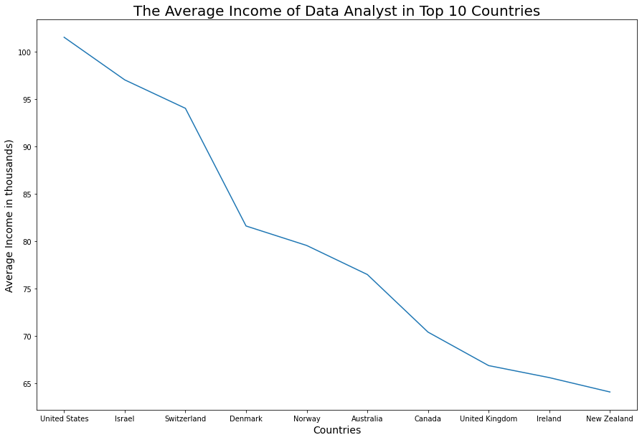
AVERGAE SALARY FOR DATA ANALYST IN THE TOP 10 COUNTRIES

Slide 15
MAP
We are here

Slide 16
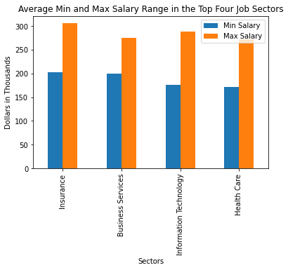
Common Data Analytics Job Title
GLASSDOOR-AVERAGE MIN AND MAX SALARY RANGE IN THE TOP FOUR JOB SECTORS

Slide 17
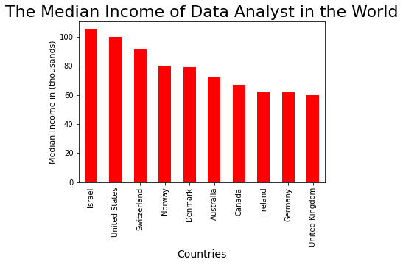

Slide 18
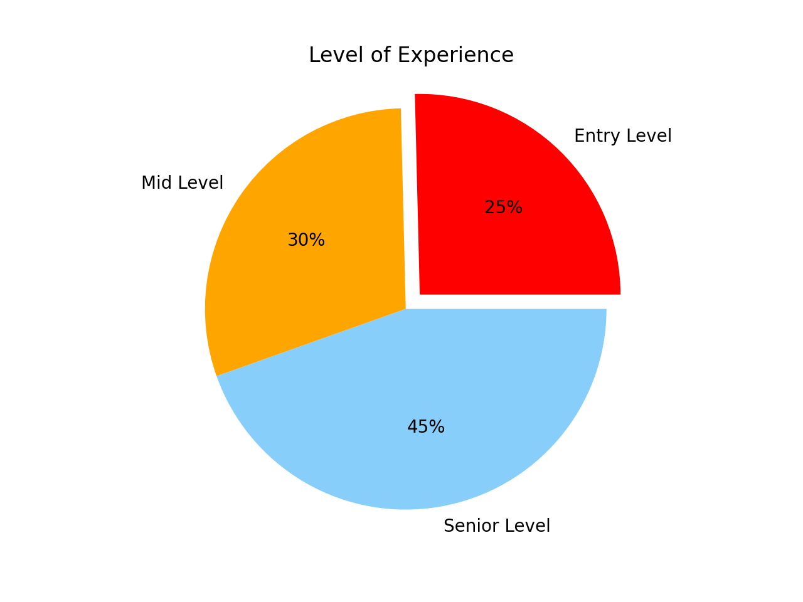
INDEED - POSITON POSTING BY AVAILABILITY LEVEL EXPERIENCE

Slide 19
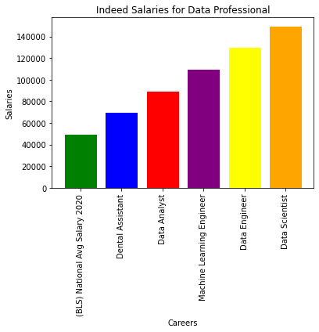
INDEED DATA

Slide 20
THANK YOU!

